Slide 1

METCS 555 Final Project Predictive Maintenance Using Jet Engine Sensor Data
Aryan Meena
U41361555
Prof. Farshid Alizadeh-Shabdiz

Slide 2
Introduction
Analyze NASA’s turbofan engine dataset to find failure indicators.
Identify sensor trends that signal engine degradation​.
Build predictive models: linear regression for Remaining Useful Life (RUL) and logistic regression for failure risk​.

Slide 3
Dataset Overview
Data: NASA C-MAPSS FD001 (100 training engines, 100 test), time-series of 21 sensors + 3 settings​
Cycles & RUL: Each engine runs until failure (last cycle has RUL=0)​.
Sampling: We randomly sampled 1000 observations across engines and life stages for manageable analysis
Standardization: Standardized units as needed (setting3 = 100 across all data)​
Cleaning: Data is simulated, so minimal cleaning. Removed constant features (sensors 1, 10, 18, 19 and setting3) to avoid singularities​

Slide 4
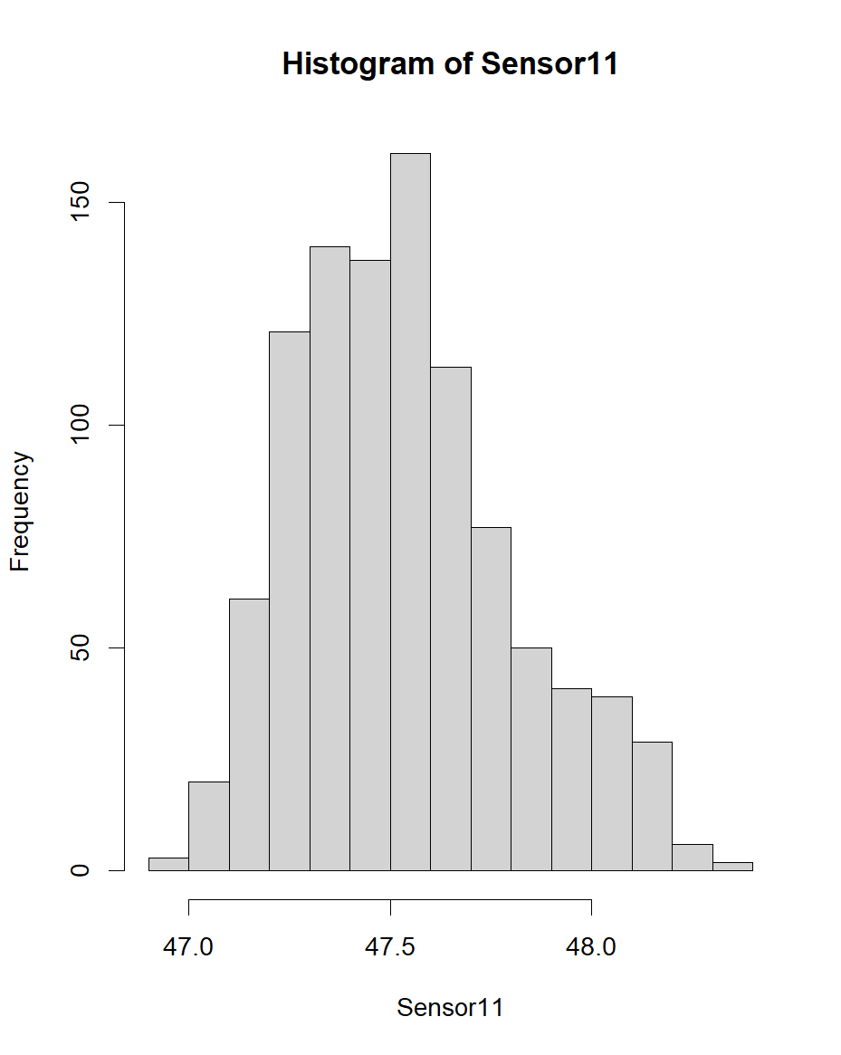
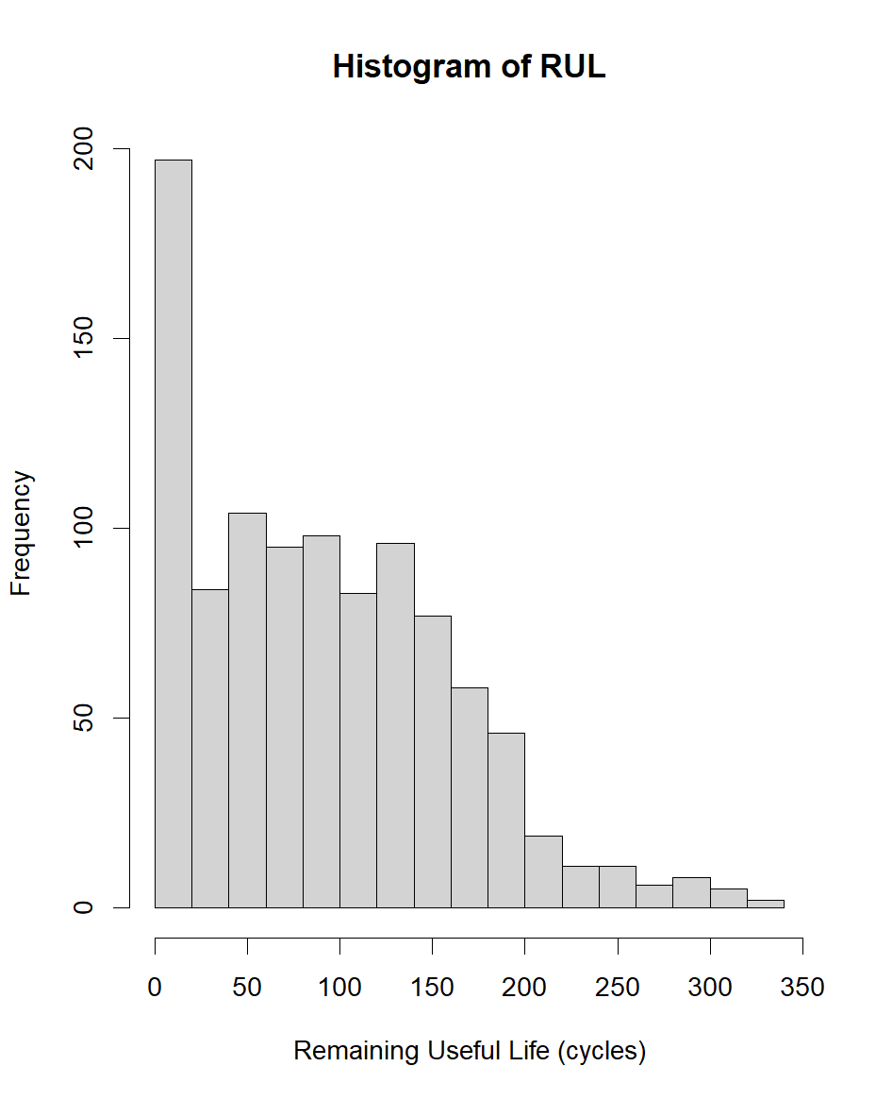
Histograms of Sensor 11 and RUL

Slide 5
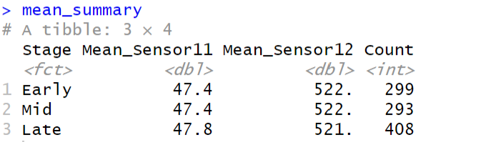
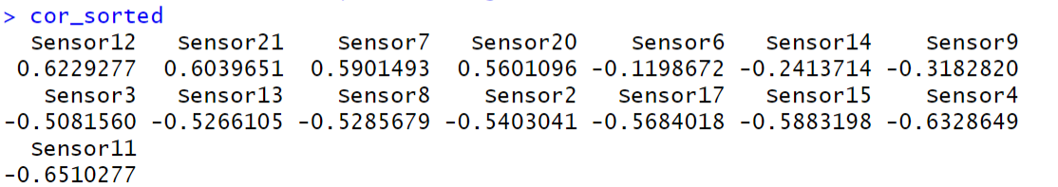
Exploratory Analysis & Sensor Significance
Trend over time: Sensor 11 consistently increases over engine life, while Sensor 12 decreases (Example: Engine 1, S11 from ~47.1→48.3; S12 from ~521.7→520.1).
Other sensors: A few sensors (s4, s7, s15, etc.) show moderate negative correlations (≈–0.58 to –0.65) with RUL
Correlations: Sensor11 vs RUL: strong negative correlation (r≈–0.65)​. Sensor12 vs RUL: positive correlation (r≈+0.623) since it drops with wear.

Slide 6
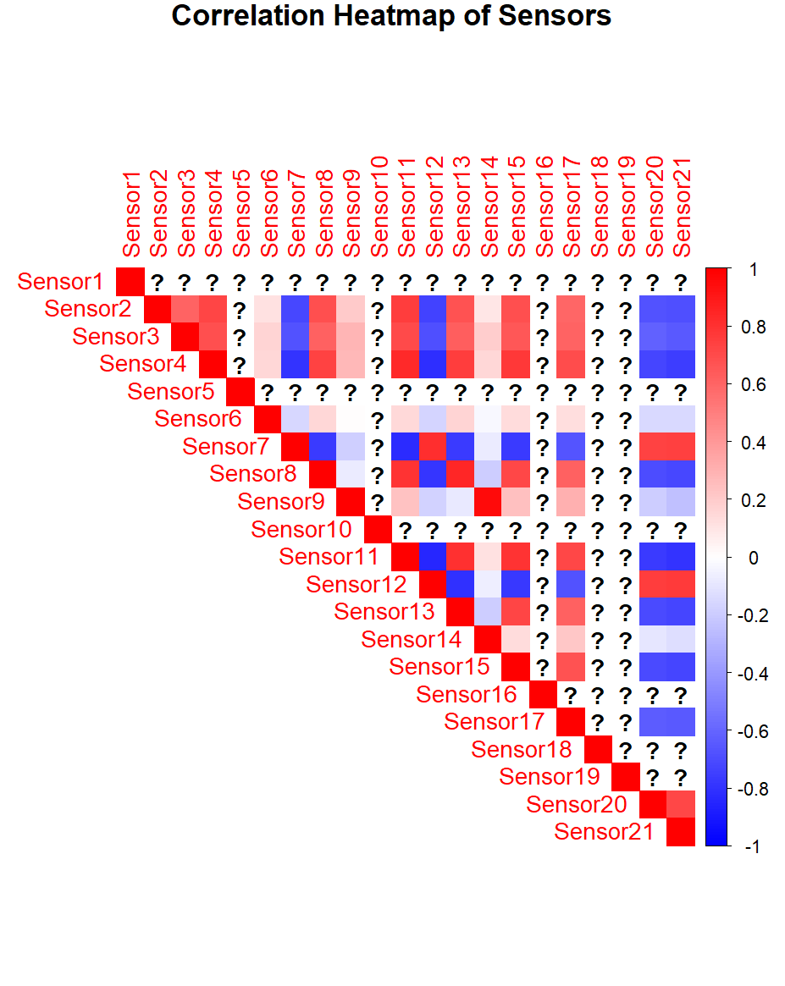
Correlation Between Sensors

Slide 7
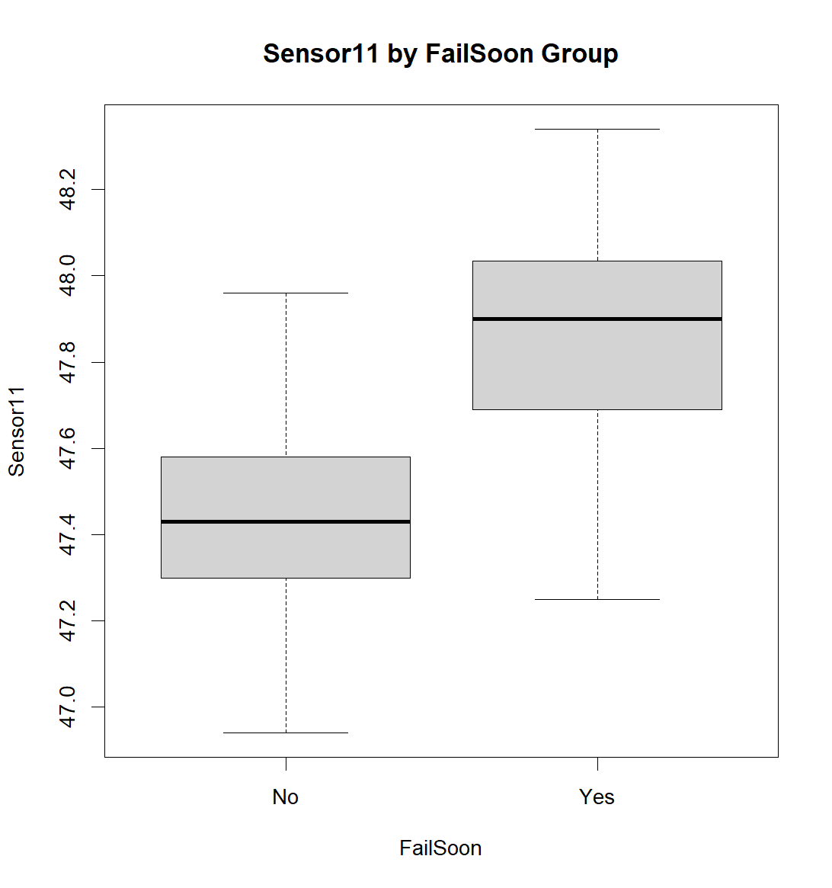
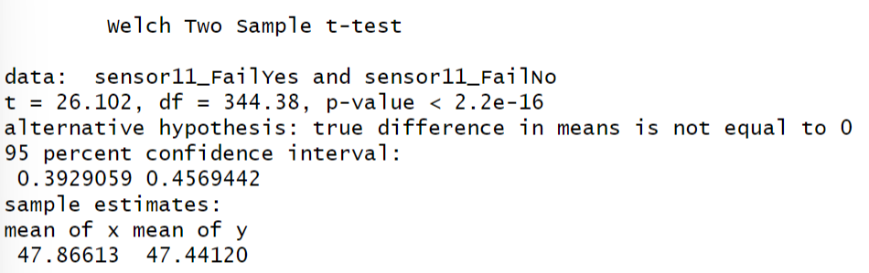
Hypothesis Testing T-tests
One-sample t-test: Is mean Sensor11 above its initial (cycle-1) value (μ0=47.34)? Yes – sample mean ~47.524 is significantly higher (t≈23.6, p<0.001)
Two-sample t-test: Compare healthy vs failing engines: High-RUL (>150 cycles) vs Low-RUL (≤30 cycles) for S11. Difference ≈0.425 (S11 higher in failing engines), p<0.0001

Slide 8
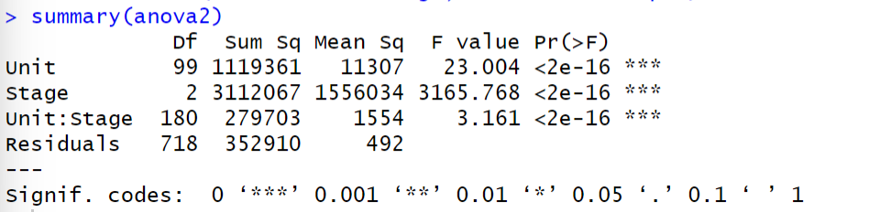
Anova (One-Way & Two Way)
One-way ANOVA: Split data into four life-stage quartiles. S11 means differ significantly (F(3,996)=343.7, p<0.0001). All Tukey pairwise differences were significant – S11 steadily increases as life stage goes from early to late.
Two-way ANOVA: Factors: Engine ID (3 engines example) and Cycle Stage (Early vs Late). Found a strong Stage effect (S11 higher in late cycles, F≈3165, p<0.0001), a modest Engine effect (baseline differences), and a significant Engine×Stage interaction (the magnitude of S11 increase differs slightly by engine)​

Slide 9
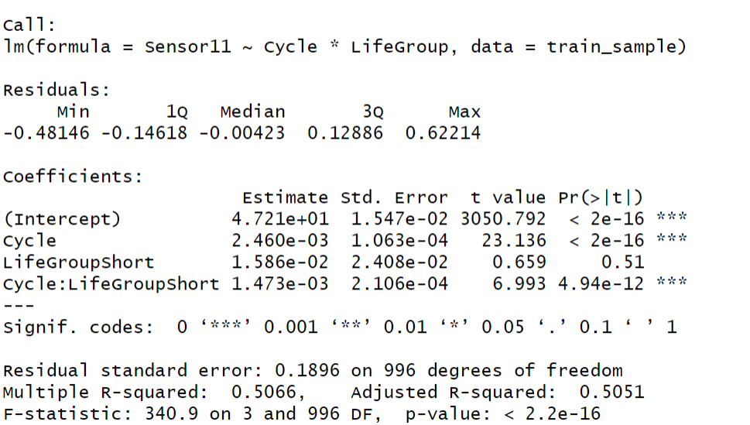
ANCOVA
ANCOVA: Factor “LifeCat” (Short-life vs Long-life engines) with cycle as covariate. The interaction (LifeCat×Cycle) was highly significant (p<2e-12) – short-life engines have a steeper S11-vs-cycle slope (faster degradation) than long-life engines​

Slide 10
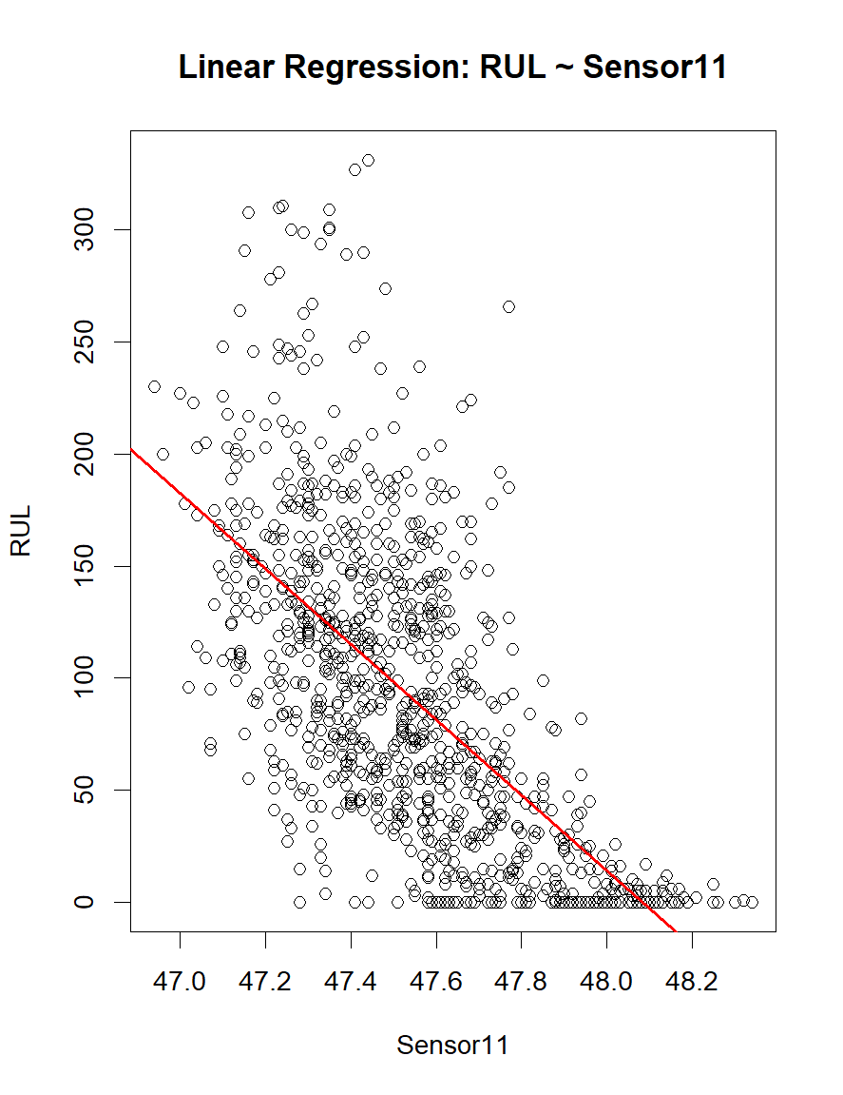
Regression Modelling
Simple regression (Sensor11): RUL vs S11. Strong negative slope (β≈–168.6 cycles/unit, p<2e-16). Model explains ~42.3% of RUL variance (R²≈0.423).
Simple regression (Cycle): RUL vs Cycle. Negative slope (β≈–0.702 cycles lost per cycle, p<2e-16), R²≈0.466 (intuition: each cycle reduces remaining life)
Multiple regression (S11 + S9): R²≈0.452 (about 45.2% of RUL variance explained).

Slide 11
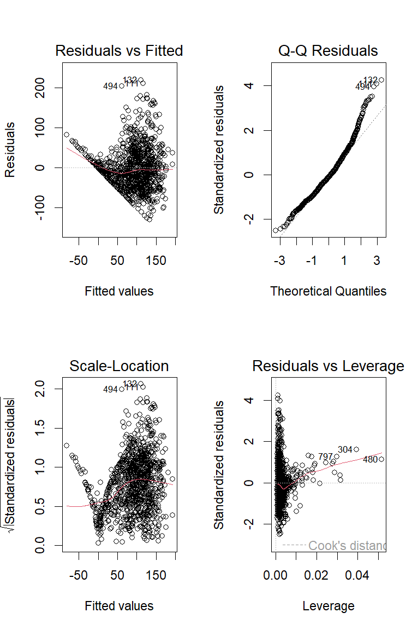
Residual Analysis
Diagnostics: Residual vs Fitted shows a funnel shape – variance grows with fitted value. Q-Q plot deviates in tails (mild non-normality). The model tends to over-predict RUL for low-RUL engines and under-predict for high-RUL, suggesting some nonlinearity or missing factors.

Slide 12
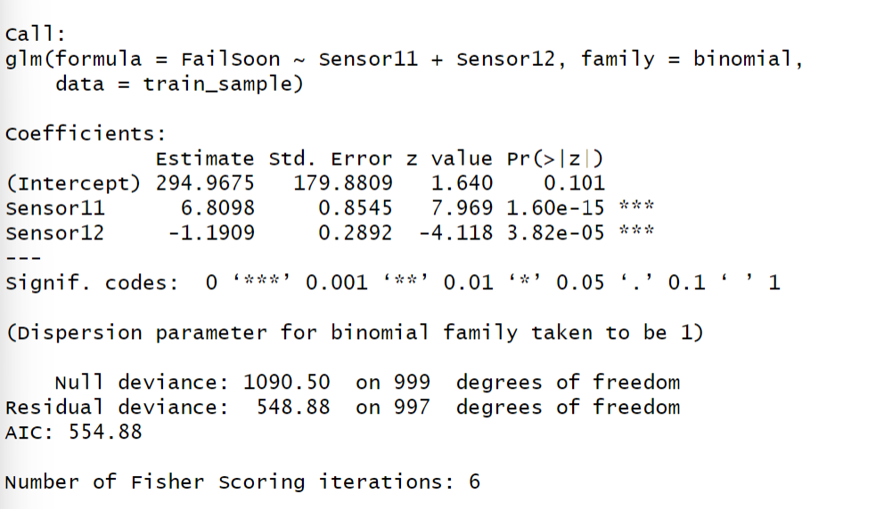
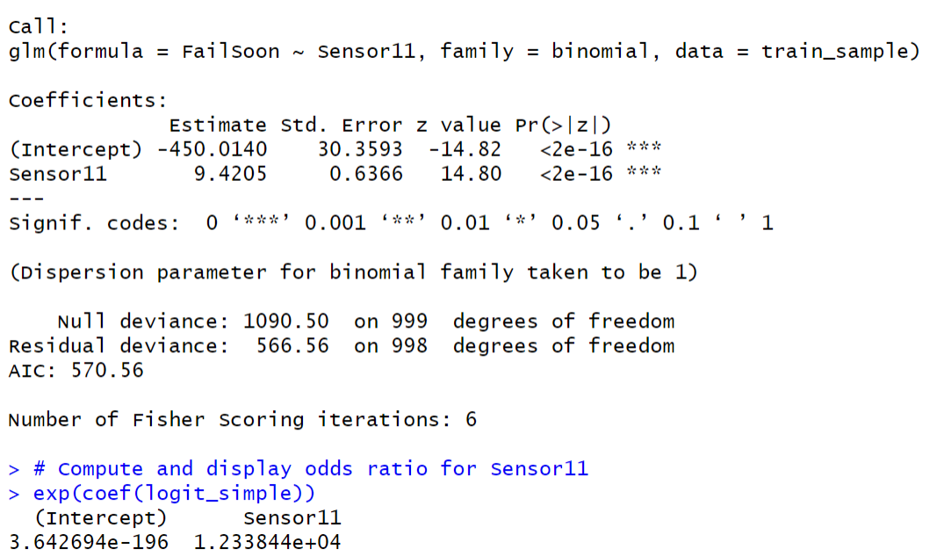
Logistic Regression
Logistic (FailSoon ~ S11): Sensor11 is an extremely strong predictor. β ≈ +9.42 (p<2e-16), implying an odds ratio ≈12,338 per unit increase. (Higher S11 dramatically increases failure risk).
Logistic (S11 + S12): Adding Sensor12 improves the model. Both remain significant (p<2e-15 for S11, p≈3.8e-5 for S12) with S11 positive, S12 negative. Deviance drops (1090.5→548.9) and AIC lowers (for better fit)

Slide 13
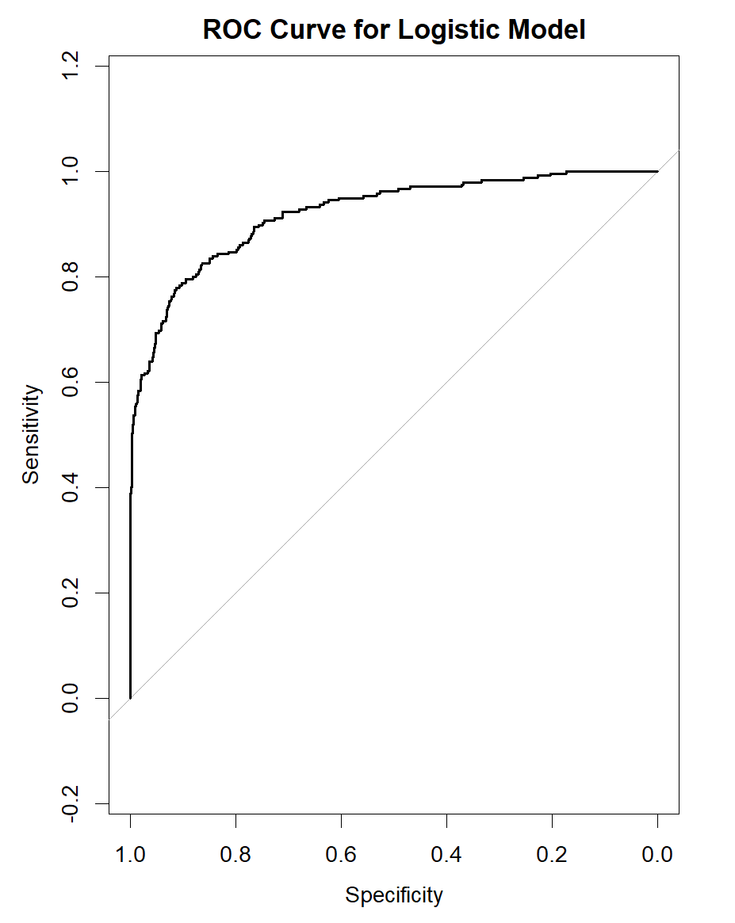
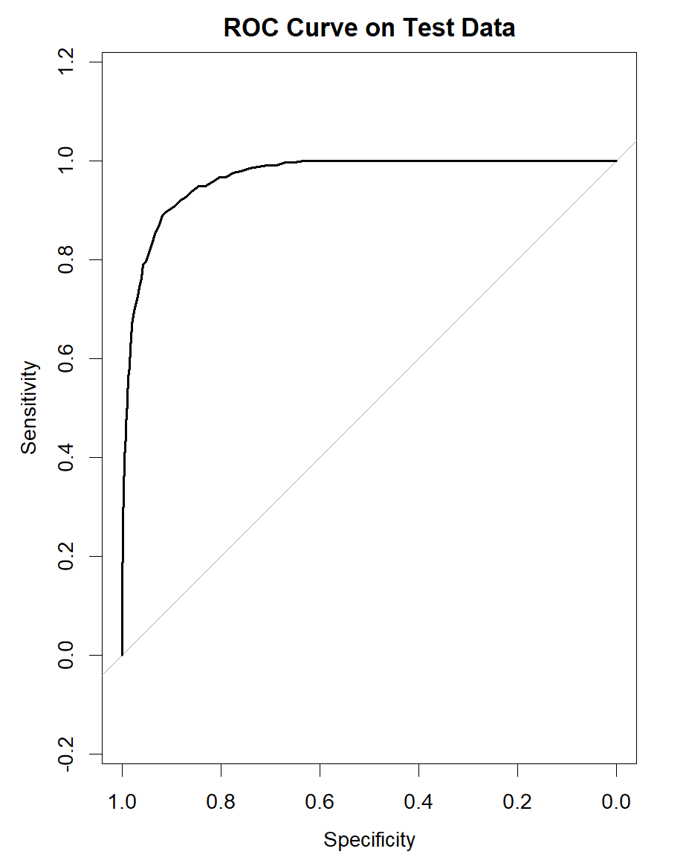

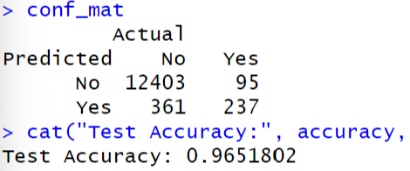
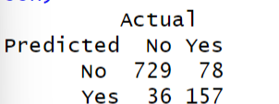

ROC Curves & Predictions Training vs Test Set
Accuracy & Sensitivity: On test data: ~89% overall accuracy, with sensitivity ~64% and specificity ~97%​file-c98qwtvkkeuizhcwclo1nd. This means almost all healthy engines are correctly spared, while a majority of true failures are caught.
Accuracy & Sensitivity: On test data: ~96% overall accuracy, with sensitivity ~64% and specificity ~97%​. This means almost all healthy engines are correctly spared, while a majority of true failures are caught.

Slide 14
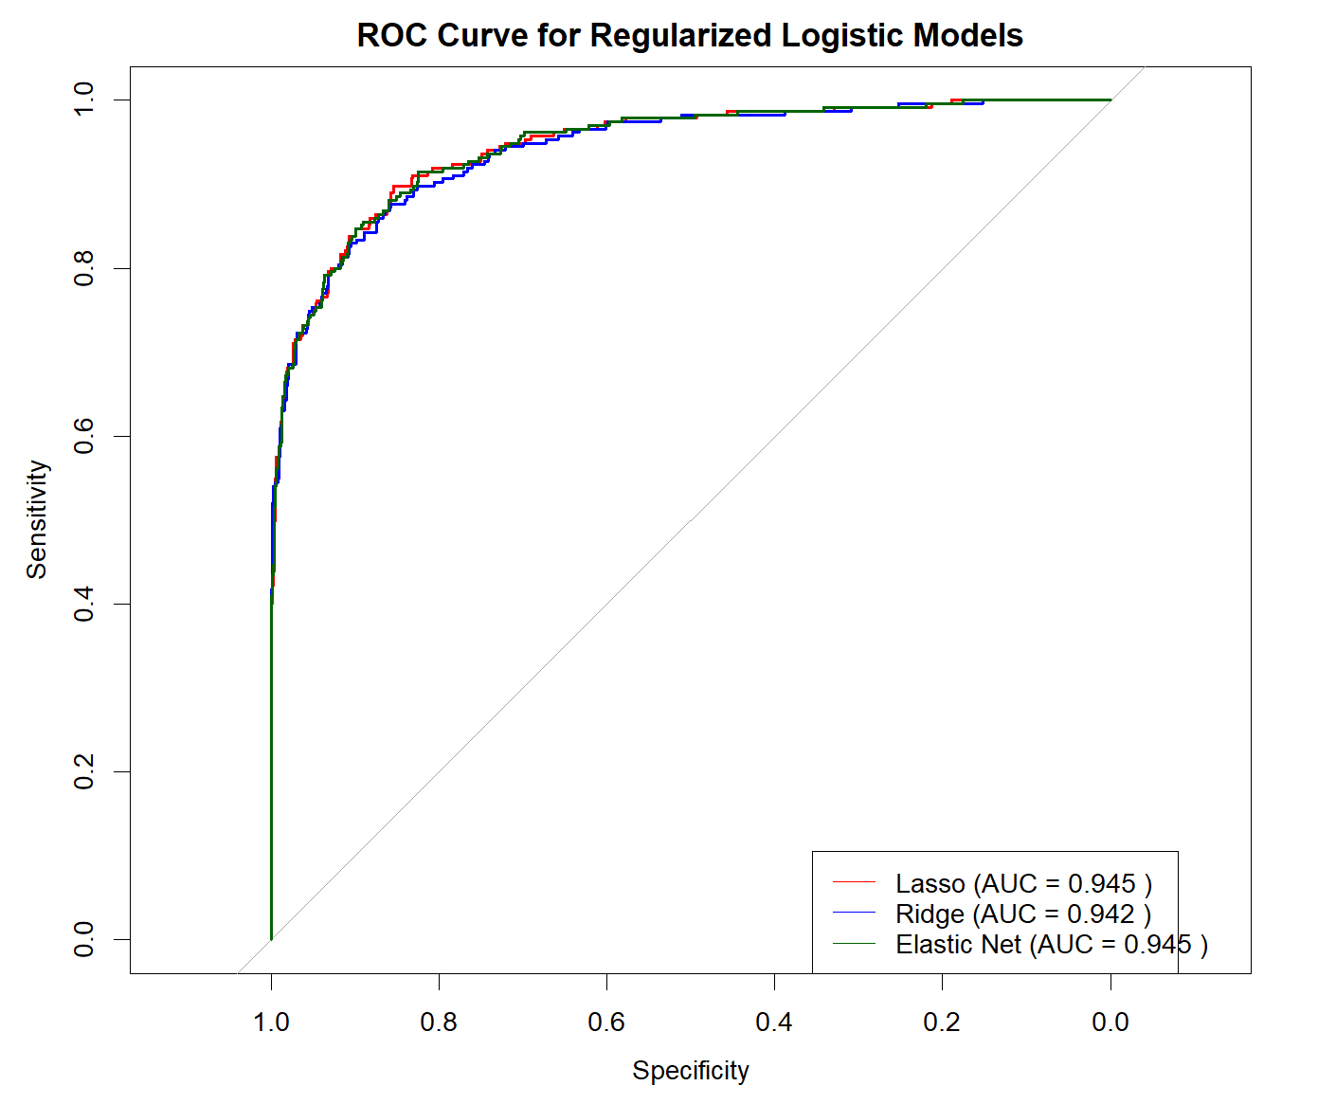
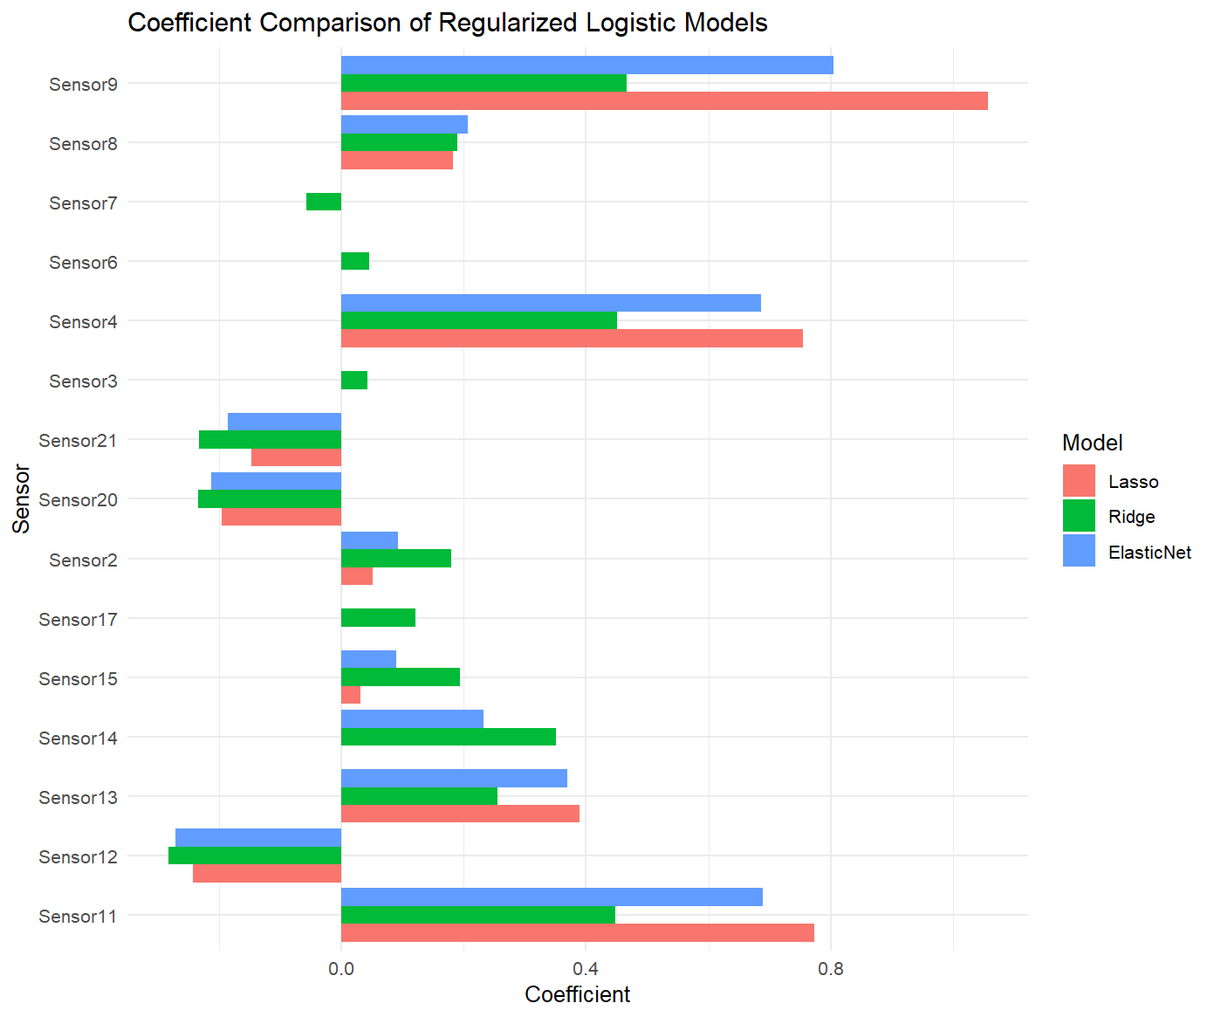
Regularization

Slide 15
Conclusion
Sensor indicators: Sensor 11 rises and Sensor 12 falls as engines approach failure; these patterns are highly significant (t-tests/ANOVA p<0.001). These sensors are effective health indicators.
Regression results: A single-sensor linear model explained about half of the RUL variability; adding a second sensor brought R² to ~50%. On test engines, this meant RUL predictions were typically within ±34 cycles on average.
Classification results: Logistic models combining one increasing sensor and one decreasing sensor achieved very high accuracy (~89–95%) in flagging engines that will fail soon. This could guide maintenance (e.g. if S11 exceeds a threshold and S12 is low, service the engine).
Degradation insight: Short-lived engines degrade faster per cycle (ANCOVA result)​. This suggests personalized maintenance schedules might be warranted.
Limitations: Results are from a subset (1,000 of ~20,000) and assume independent observations, which isn’t fully true (cycles in an engine are correlated)​. Linear models may miss nonlinear effects. Despite these, the core findings (sensor trends, model validity) are robust.

Slide 16
References & Final Thoughts
Key References: Saxena et al. (2008) – C-MAPSS FD001 dataset​; Friedman et al. (2010) – regularized GLMs (glmnet)​; Montgomery & Runger (2018) – statistical methods.
Future Work: Apply methods to larger/full dataset (all 20k points), include multiple operating conditions (FD002–FD004), and explore nonlinear or machine-learning models. Also, tune the failure-threshold (30-cycle window) for operational needs.
THANKYOU

